Slide 1
Basic Details of the Team and Problem Statement
PSID: PS ID-06
Problem Statement Title: Fake News Detection
Team Name: Mavericks
Team Leader Name: Karunya N
Institute Name: Rajalakshmi Institute of Technology
City: Chennai

Slide 2
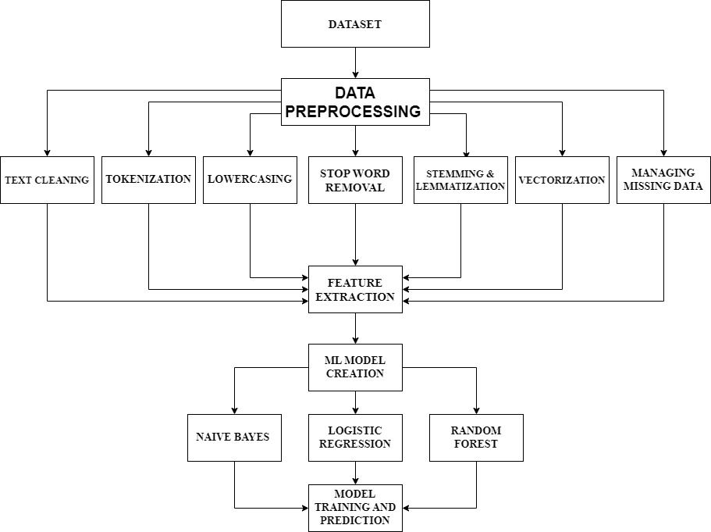
Idea/Approach Details
Describe your idea/Solution/Prototype here:
Using Python and Machine Learning: The project fights fake news with Python and machine learning tools like scikit-learn for analysis.
Dataset Selection: They use the "MANUAL TESTING" dataset, 10,000 news articles labeled as real or fake.
Data Preprocessing: Cleaning, tokenization, and other steps are taken to prepare the data for machine learning.
Feature Extraction: Words are converted to numbers using TF-IDF for machine learning algorithms.
Machine Learning Algorithms: Naive Bayes, Logistic Regression, and Random Forest are used to detect fake news.
Model Training and Prediction: Models are trained on labeled data to predict the authenticity of new articles.
Challenges and Limitations: They recognize challenges like misinformation tactics, biases, and model generalization.
Model Improvement: They plan to enhance the model through preprocessing and tuning for real-world use.
Importance of Dataset Quality: A diverse and high-quality dataset ensures a better-performing model.
Promoting Trustworthy Information: The project aims to create a reliable system to prevent the spread of false information and promote trust in news
Web Application: Implementing the Model into a web application with features like reporting fake news source etc.
Describe your Technology stack here:
Programming Language – Python
Libraries – NLTK (Data processing) , NumPy, Pandas (Data Handling) , Matplotlib, seaborn (Data Visualization)
Term Frequency – Inverse Document Frequency – Feature extraction
Model Evaluation – Scikit learn
Collaboration – GitHub
Web Applications – HTML, CSS, JS and JS frameworks as well as Django and Flask frameworks.

Slide 3
Idea/Approach Details
Describe your Use Cases here
Describe your Dependencies / Show stopper here
Social Media Content Filtering: Integrating the system into social media platforms automatically flag or hide potentially fake articles reducing online scams
News Aggregating Platforms: Allows people to verify the credibility of the numerous websites which circulate news articles over the web
Online Forums and Discussion Platforms: Integrating the system into forums and discussions to prevent the dissemination of misleading information among users.
Web Browsers and Extensions: Developing browser extensions that alert users when they access potentially unreliable news sources.
Healthcare Information Verification: Integrating the system into healthcare portals to validate the authenticity of health-related news and advice, preventing the spread of misleading medical information.
Dependencies:
Data Availability: The availability of a diverse and labeled dataset of fake and real news articles is crucial for training a reliable machine learning model. Gathering this data may require cooperation from fact-checking organizations or access to reputable datasets
Integration with Web Application: For the web-based prototype, knowledge of web development and frameworks is necessary to integrate the model into the user interface effectively.
Model Evaluation and Fine-Tuning: Regular evaluation and fine-tuning of the model are essential to maintain its accuracy and adapt to evolving trends in misinformation.
Show Stoppers:
Legal and Ethical Concerns: Detecting and combating fake news involves sensitive issues related to freedom of speech and censorship.
Lack of Representative Data: If the dataset used for training the model is not representative of the target population or is biased, the model may not perform well in real-world scenarios, leading to unreliable predictions.
User Interface and Adoption: Even with a highly accurate model, user adoption and trust in the system can be a challenge. A user-friendly and transparent interface is necessary to gain user confidence.

Slide 4
Effort, Cost and Time line
Efforts:
Collect a diverse dataset of news articles and preprocess the data to remove noise and prepare it for analysis.
Experiment with various machine learning algorithms and fine-tune the selected model to identify fake news effectively.
Develop a user-friendly web application or API for users to input news articles and receive verification results.
Regularly evaluate the model's performance using metrics like accuracy and F1-score, and make necessary improvements.
Implement a real-time verification mechanism to keep the model up-to-date with the latest misinformation trends.
Provide a feedback system for users to share their insights and offer customer support to address inquiries and concerns.

Slide 5
Team Member Details
SI. No. | Name of Team Member | Branch (Btech/Mtech/PhD etc): | Stream (ECE, CSE etc): | Year | Position in team (Team Leader, Front end Developer, Back end Developer, Full Stack, Data base management etc.)
1 | Karunya N | B.Tech | AI&DS | 3rd | Team Leader
2 | Karunya N | B.Tech | AI&DS | 3rd | Model Deployment
3 | Kishore A | B.Tech | AI&DS | 3rd | Full Stack
4 | Kathirvel S | B.Tech | AI&DS | 3rd | Full Stack
Team Mentor Details
SI. No. | Name of Mentor | Category (Academic/Industry): | Expertise (AI/ML/Blockchain etc): | Domain Experience (in Years )
1

